Slide 1

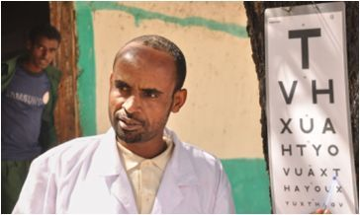

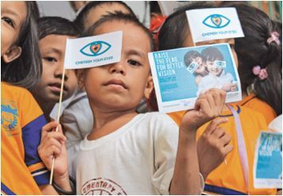


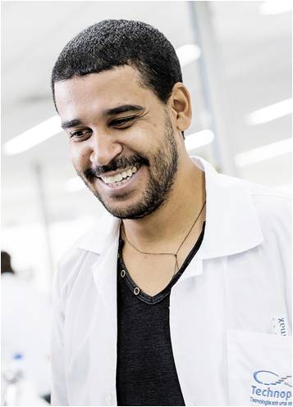
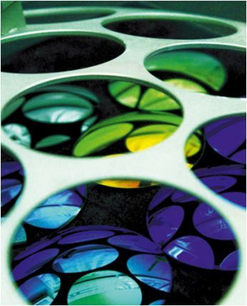
Eyecloud : Interaction between EU Systems

Slide 2
Summary
Why a new version of Eyecloud ?
Difference between V2 and V3
Orchestra and SAP : Solution
1
2
3
4
5
6
Eyecloud Volume in EU
Orchestra and SAP: Issue
What about KPB ?

Slide 3
Introduction : Why we're implementing a new Eyecloud version
Context
Eyecloud will be more and more called by systems (especially in Europe)
Stake
To respond to this, Eyecloud needs to evolve by building a more robust and more available platform.
Solution
The implementation of Eyecloud V3 aims to build this High available platform in order to be ready for the increase in demand

Slide 4
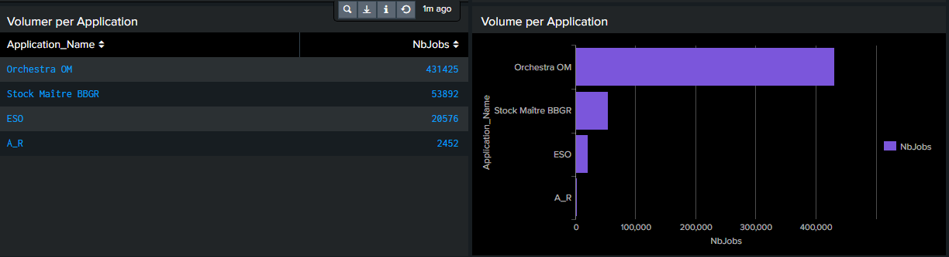
Eyecloud Volume per EU Systems (Last 24hours)

Slide 5
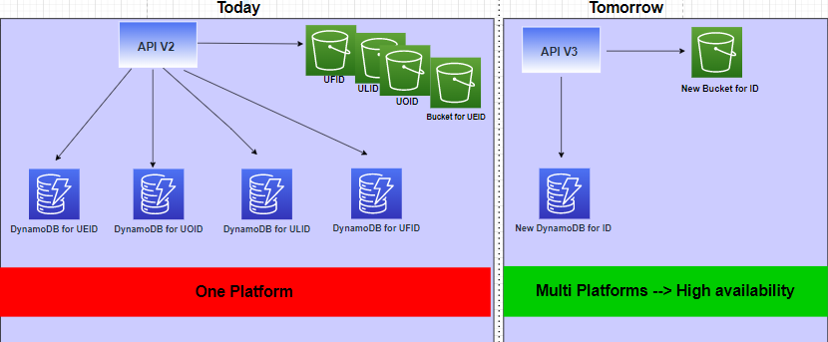
Difference between V2 and V3 : Infrastructure
 | V2 | V3
URL | https://in-eyecloud.rxdigitalplatform.com/v2/uoid | https://in-ec-prd.rxdigitalplatform.com/v3/ecid
Eyecloud ID Format | Alphanumeric with 8 Characters | Alphanumeric with 12 characters
 | Lowercase only | Case sensitive (lower and capital letter)

Slide 6
Interaction between Orchestra and SAP sharing Eyecloud ID : Issue
Share the UOID with SAP
Orchestra
4
SAP
POST a Document with the UOID gotten from Orchestra
UOID not present, Impossible to store document
8
5
Get back UOID
from Eyecloud
3
1
Ask UOID to Eyecloud
Eyecloud API V3
Eyecloud API V2
UOID not present
7
6
Check if ID is present before posting Document on It
Save the UOID in DynamoDB
2
UEID
UFID
ULID
UOID
ECID
S3 bucket
S3 bucket
S3 bucket
S3 bucket
S3 bucket
DynamoDB
DynamoDB
DynamoDB
DynamoDB
DynamoDB

Slide 7
Interaction between Orchestra and SAP sharing Eyecloud ID : Solution
Share the ECID with SAP
Orchestra
4
SAP
Get back ECID
from Eyecloud
3
1
Ask ECID to Eyecloud
5
POST a Document with the ECID gotten from Orchestra
Eyecloud API V3
2
Save the ECID in DynamoDB
ECID
S3 bucket
DynamoDB

Slide 8
What about KPB Lisbon ?
Context
Today, KPB Lisbon is calling Eyecloud on our Preproduction environment (they want to move forward on Production soon)
Questions
Will KPB be replaced by SAP ?
Today, KPB is only creating IDs on Eyecloud. Does it Share those IDs to another Systems (like Orchestra will share to SAP)

